Slide 1
Processor Architecture I:
ISA & Logic Design
Introduction to Computer Systems
9th Lecture, Oct 15, 2026

Slide 2
Part A
Instruction Set Architecture

Slide 3
Instruction Set Architecture
ISA:
  Processor state
    Registers, memory
  Instructions
    addq, pushq, ret, …
Contract between HW and SW:
  Above: how SW programs?
  Below: how HW implements?
Application
Program
Compiler
OS
ISA
CPU
Design
Circuit
Design
Chip
Layout

Slide 4
Y86-64 processor state
RF: Program registers
CC: Condition codes
Stat: Program status
%rax
%rsp
%r8
%r12
%rcx
%rbp
%r9
%r13
ZF
SF
OF
DMEM: Memory
%rdx
%rsi
%r10
%r14
PC
%rbx
%rdi
%r11
  Program Registers (diff)
    15 64-bits registers (omit %r15).
  Single-digit condition Codes (diff)
    ZF: Zero SF:Negative OF: Overflow
  Program Counter (same)
  Program Status (same)
  Memory (same)
    Little-endian

Slide 5
Encoding Y86-64 Instructions
Remember: instruction is stored as binary data in memory
Format: 1–10 bytes
    First byte: instruction type
    Second byte: function (specific instructions within one type)
    Starting from third byte: oprands (memory addresses, registers)

Slide 6
Y86-64 Instructions #1
Byte
0
1
2
3
4
5
6
7
8
9
halt
0
0
nop
1
0
cmovXX rA, rB
2
fn
rA
rB
irmovq V, rB
3
0
F
rB
V
rmmovq rA, D(rB)
4
0
rA
rB
D
mrmovq D(rB), rA
5
0
rA
rB
D
OPq rA, rB
6
fn
rA
rB
jXX Dest
7
fn
Dest
call Dest
8
0
Dest
ret
9
0
pushq rA
A
0
rA
F
popq rA
B
0
rA
F

Slide 7
Y86-64 Instruction Set #2
rrmovq
2
0
Byte
0
1
2
3
4
5
6
7
8
9
cmovle
2
1
halt
0
0
cmovl
2
2
nop
1
0
cmove
2
3
cmovXX rA, rB
2
fn
rA
rB
cmovne
2
4
irmovq V, rB
3
0
F
rB
V
cmovge
2
5
rmmovq rA, D(rB)
4
0
rA
rB
D
cmovg
2
6
mrmovq D(rB), rA
5
0
rA
rB
D
OPq rA, rB
6
fn
rA
rB
jXX Dest
7
fn
Dest
call Dest
8
0
Dest
ret
9
0
pushq rA
A
0
rA
F
popq rA
B
0
rA
F

Slide 8
Y86-64 Instruction Set #3
Byte
0
1
2
3
4
5
6
7
8
9
halt
0
0
nop
1
0
cmovXX rA, rB
2
fn
rA
rB
irmovq V, rB
3
0
F
rB
V
rmmovq rA, D(rB)
4
0
rA
rB
D
addq
6
0
mrmovq D(rB), rA
5
0
rA
rB
D
subq
6
1
OPq rA, rB
6
fn
rA
rB
andq
6
2
jXX Dest
7
fn
Dest
xorq
6
3
call Dest
8
0
Dest
ret
9
0
pushq rA
A
0
rA
F
popq rA
B
0
rA
F

Slide 9
Y86-64 Instruction Set #4
6
7
8
jmp
9
Byte
0
1
2
3
4
5
7
0
halt
0
0
jle
7
1
nop
1
0
jl
7
2
cmovXX rA, rB
2
fn
rA
rB
je
7
3
irmovq V, rB
3
0
F
rB
V
jne
7
4
rmmovq rA, D(rB)
4
0
rA
rB
D
jge
7
5
mrmovq D(rB), rA
5
0
rA
rB
D
jg
7
6
OPq rA, rB
6
fn
rA
rB
jXX Dest
7
fn
Dest
call Dest
8
0
Dest
ret
9
0
pushq rA
A
0
rA
F
popq rA
B
0
rA
F

Slide 10
Y86-64 Instructions
Format: 1–10 bytes
    First byte: instruction type
    Second byte: function (specific instructions within one type)
    Starting from third byte: oprands (memory addresses, registers)
Each register has 4-bit ID (almost same as x86)
Except for 0xF indicates “no register”
  Use in our hardware design
%rax
0
%r8
8
%rcx
1
%r9
9
%rdx
2
%r10
A
%rbx
3
%r11
B
%rsp
4
%r12
C
%rbp
5
%r13
D
%rsi
6
%r14
E
%rdi
7
No Register
F

Slide 11
Instruction Example
Addition Instruction
  e.g., addq %rax,%rsi Encoding: 60 06
Encoded Representation
addq rA, rB
6
0
rA
rB

Slide 12
Move Operations
Register ➔ Register
rrmovq rA, rB
2
0
rA
rB
Immediate ➔ Register
irmovq V, rB
3
0
F
rB
V
Register ➔ Memory
rmmovq rA, D(rB)
4
0
rA
rB
D
Memory ➔ Register
mrmovq D(rA), rB
5
0
rB
rA
D
  Like the x86-64 movq instruction with simpler addressing mode

Slide 13
Move Instruction Examples
X86-64
Y86-64
movq $0xabcd, %rdx
irmovq $0xabcd, %rdx
Encoding:
30 f2 cd ab 00 00 00 00 00 00
movq %rsp, %rbx
rrmovq %rsp, %rbx
Encoding:
20 43
movq -12(%rbp),%rcx
mrmovq -12(%rbp),%rcx
Encoding:
50 15 f4 ff ff ff ff ff ff ff
movq %rsi,0x41c(%rsp)
rmmovq %rsi,0x41c(%rsp)
Encoding:
40 64 1c 04 00 00 00 00 00 00

Slide 14
Conditional Move Instructions
Move Unconditionally
rrmovq rA, rB
2
0
rA
rB
  Refer to generically as “cmovXX”
  Variants of rrmovq instruction
  Encodings differ only by “function code”
  Based on values of condition codes
    cmovne performs when ZE is clear
Move When Less or Equal
cmovle rA, rB
2
1
rA
rB
Move When Less
cmovl rA, rB
2
2
rA
rB
Move When Equal
cmove rA, rB
2
3
rA
rB
Move When Not Equal
cmovne rA, rB
2
4
rA
rB
Move When Greater or Equal
cmovge rA, rB
2
5
rA
rB
Move When Greater
cmovg rA, rB
2
6
rA
rB

Slide 15
Jump Instructions
Jump (Conditionally)
jXX Dest
7
fn
Dest
  Same as x86-64 counterparts
  Refer to generically as “jXX”
  Encodings differ only by “function code” fn
  Based on values of condition codes
    je 0x100 only jumps if ZF is set

Slide 16
Jump Instructions
Jump Unconditionally
jmp Dest
7
0
Dest
Jump When Less or Equal
jle Dest
7
1
Dest
Jump When Less
jl Dest
7
2
Dest
Jump When Equal
je Dest
7
3
Dest
Jump When Not Equal
jne Dest
7
4
Dest
Jump When Greater or Equal
jge Dest
7
5
Dest
Jump When Greater
jg Dest
7
6
Dest

Slide 17
Y86-64 Program Stack (same as x86)
Stack “Bottom”
  Supporting procedure calls
  Stack top indicated by %rsp
  Stack grows toward lower addresses
•
•
•
Increasing
Addresses
%rsp
Stack “Top”

Slide 18
Stack Operations (same as x86)
pushq rA
A
0
rA
F
  Decrement %rsp by 8
  Store word from rA to memory at %rsp
  Read word from memory at %rsp to register rA
  Increment %rsp by 8
popq rA
B
0
rA
F

Slide 19
Function Call and Return (same as x86)
call Dest
8
0
Dest
  Push address of next instruction onto stack, and go to dest
  Pop value from stack as address for next instruction
ret
9
0

Slide 20
Miscellaneous Instructions
nop
1
0
  Don’t do anything
  Stop executing instructions; put the processor into low-power mode
  We will use it to stop the simulator
halt
0
0

Slide 21
Status Conditions
Mnemonic | Code
AOK | 1
  Normal operation
  Halt instruction encountered
  Bad address (either instruction or data) encountered
  Invalid instruction encountered
Desired Behavior
  If AOK, keep going
  Otherwise, stop program execution
Mnemonic | Code
HLT | 2
Mnemonic | Code
ADR | 3
Mnemonic | Code
INS | 4

Slide 22
Writing Y86-64 Code
Coding Example
  Find number of elements in null-terminated list
    int len1(long * a);
a
5043
6125
⇒ 3
7395
0

Slide 23
x86-64 Code
Problem
  Can we translate this to Y86?
/* Find number of elements in
null-terminated list */
long len(long * a)
{
long len;
for (len = 0; a[len]; len++)
;
return len;
}
L3:
addq $1,%rax
cmpq $0, (%rdi,%rax,8)
jne L3

Slide 24
Y86-64 Code Generation Example #3
len:
irmovq $1, %r8 # Constant 1
irmovq $8, %r9 # Constant 8
irmovq $0, %rax # len = 0
mrmovq (%rdi), %rdx # val = *a
andq %rdx, %rdx # Test val
je Done # If zero, goto Done
Loop:
addq %r8, %rax # len++
addq %r9, %rdi # a++
mrmovq (%rdi), %rdx # val = *a
andq %rdx, %rdx # Test val
jne Loop # If !0, goto Loop
Done:
ret
Register | Use
%rdi | a
%rax | len
%rdx | val
%r8 | 1
%r9 | 8

Slide 25
Part B
Logic Design

Slide 26
Digital Signals
0
1
0
Voltage
Time
  Use voltage thresholds to extract 0 and 1

Slide 27
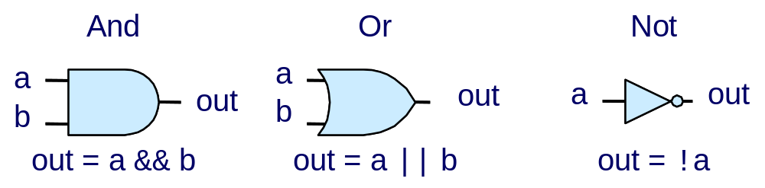
Computing with Logic Gates
  Outputs are Boolean functions of inputs

Slide 28
Bit Equality
Bit equal
a
out
b
  Generate 1 if a and b are equal

Slide 29
Word Equality
Word-Level Representation
b₆₃
Bit equal
eq₆₃
B
=
Eq
a₆₃
b₆₂
Bit equal
eq₆₂
A
a₆₂
Eq
b₁
Bit equal
eq₁
a₁
  64-bit word size
b₀
Bit equal
eq₀
a₀

Slide 30
Bit-Level Multiplexor
s
Bit MUX
b
out
a
  Output a when s=1, b when s=0

Slide 31
Word Multiplexor
s
Word-Level Representation
s
B
MUX
b₆₃
Out
out₆₃
A
a₆₃
b₆₂
out₆₂
a₆₂
  Select input word A or B depending on control signal s
b₀
out₀
a₀

Slide 32
Arithmetic Logic Unit
0
1
2
3
Y
A
Y
A
Y
A
Y
A
A
L
U
A
L
U
A
L
U
A
L
U
X + Y
X - Y
X & Y
X ^ Y
X
B
OF
X
B
OF
X
B
OF
X
B
OF
ZF
ZF
ZF
ZF
CF
CF
CF
CF
  Control signal selects function computed
    Corresponding to 4 arithmetic/logical operations in Y86-64

Slide 33
Registers
Structure
i₇
D
o₇
C
Q+
i₆
D
o₆
C
Q+
i₅
D
o₅
C
Q+
i₄
D
o₄
C
Q+
i₃
D
o₃
C
Q+
i₂
D
o₂
C
Q+
i₁
D
o₁
C
Q+
i₀
D
o₀
C
Q+
Clock
  Stores data with latches

Slide 34
Register file
valA
Register
file
srcA
A
valW
Read ports
W
dstW
Write port
valB
srcB
B
Clock
  Register file
    Holds values of program registers
    %rax, %rsp, etc.
    Register identifier serves as address
      ID 15 (0xF) implies no read or write performed
  Multiple Ports
    Can read and/or write multiple registers

Slide 35
Memory is the same
valA
Memory
addrA
A
valW
Ports
W
addrW
Write port
valB
addrB
B
Clock

Slide 36
Timing

Slide 37
Computing with Logic Gates
  Outputs are Boolean functions of inputs
  Respond continuously to changes in inputs
    With some, small delay
Rising Delay
Falling Delay
a && b
b
Voltage
a
Time

Slide 38



Combinational Circuits
Network
Primary
Inputs
Primary
Outputs
Network of Logic Gates
  Continously responds to changes on primary inputs
  Primary outputs become (after some delay) Boolean functions of primary inputs

Slide 39
Register Operation
State = x
State = y
x
Rising
clock
y
Input = y
Output = x


Output = y
  Stores data bits
  Acts as barrier between input and output
  As clock rises, loads input

Slide 40
Register File Timing
Reading
  Like combinational logic
  Output data generated based on input address
    After some delay
Writing
  Update only as clock rises
valA
Register
file
2
x
srcA
A
x
valB
srcB
B
2
Register
file
2
x
Register
file
valW
2
y
y
Rising
clock
valW
W
dstW


2
W
dstW
Clock
Clock

Slide 41
State Machine Example
Comb. Logic
0
  Accumulator circuit
  Load or accumulate on each cycle
A
L
U
MUX
0
Out
In
1
Load
Clock
Clock
Load
In
x₀
x₁
x₂
x₃
x₄
x₅
Out
x₀
x₀+x₁
x₀+x₁+x₂
x₃
x₃+x₄
x₃+x₄+x₅

Slide 42
Hardware Control Language
  Simplified hardware description language, similar to C
Data Types
  bool:
    a, b, c, …
  int:
    A, B, C, …
    Does not specify word size---bytes, 64-bit words, …
Statements
  bool a = bool-expr ;
  int A = int-expr ;

Slide 43
HCL Operations
  Classify by type of value returned
Boolean Expressions
  Logic Operations
    a && b, a || b, !a
  Word Comparisons
    A == B, A != B, A < B, A <= B, A >= B, A > B
  Set Membership
    A in { B, C, D }
      Same as A == B || A == C || A == D
Word Expressions
  Case expressions
    [ a : A; b : B; c : C ]
    Evaluate test expressions a, b, c, … in sequence
    Return word expression A, B, C, … for first successful test

Slide 44
Bit Equality
Bit equal
a
HCL Expression
out
bool out = (a&&b)||(!a&&!b)
b
  Generate 1 if a and b are equal
Hardware Control Language (HCL)
  Very simple hardware description language, similar to C
  We’ll use it to describe control logic for processors

Slide 45
Bit-Level Multiplexor
s
Bit MUX
HCL Expression
bool out = (s&&a)||(!s&&b)
b
out
a
  Output a when s=1, b when s=0

Slide 46
Word Equality
Word-Level Representation
b₆₃
Bit equal
eq₆₃
B
=
Eq
a₆₃
b₆₂
Bit equal
eq₆₂
A
a₆₂
HCL Representation
Eq
bool Eq = (A == B)
b₁
Bit equal
eq₁
a₁
  64-bit word size
b₀
Bit equal
eq₀
a₀

Slide 47
Word Multiplexor
s
Word-Level Representation
s
B
MUX
b₆₃
Out
out₆₃
A
a₆₃
HCL Representation
b₆₂
int Out = [
s : A;
1 : B;
];
out₆₂
a₆₂
  Select input word A or B depending on control signal s
b₀
out₀
a₀

Slide 48
HCL Examples
Minimum of 3 Words
  Find minimum of three input words
int Min3 = [
A < B && A < C : A;
B < A && B < C : B;
1 : C;
];
C
MIN3
B
Min3
A
4-Way Multiplexor
s1
s0
  Select one of 4 inputs based on two control bits
MUX4
int Out4 = [
!s1&&!s0: D0;
!s1 : D1;
!s0 : D2;
1 : D3;
];
D0
D1
Out4
D2
D3

Slide 49
Summary
Computation
  Performed by combinational logic
  Computes Boolean functions
  Continuously reacts to input changes
Storage
  Registers
    Hold single words
    Loaded as clock rises
  Random-access memories
    Hold multiple words
    Possible multiple read or write ports
    Read word when address input changes
    Write word as clock rises

Slide 50
Jump Instructions
Jump (Conditionally)
jXX Dest
7
fn
Dest
  Refer to generically as “jXX”
  Encodings differ only by “function code” fn
  Based on values of condition codes
  Same as x86-64 counterparts
  Encode full destination address
    Unlike PC-relative addressing seen in x86-64

Slide 51
Y86-64 Sample Program Structure #1
init: # Initialization
. . .
call Main
halt
.align 8 # Program data
array:
. . .
Main: # Main function
. . .
call len . . .
len: # Length function
. . .
.pos 0x100 # Placement of stack
Stack:
  Program starts at address 0
  Must set up stack
  Must initialize data

Slide 52
Y86-64 Program Structure #2
init:
# Set up stack pointer
irmovq Stack, %rsp
# Execute main program
  call Main
  # Terminate
  halt
# Array of 4 elements + terminating 0
.align 8
Array:
.quad 0x000d000d000d000d
  .quad 0x00c000c000c000c0
.quad 0x0b000b000b000b00
.quad 0xa000a000a000a000
.quad 0
  Program starts at address 0
  Must set up stack
  Must initialize data
  Can use symbolic names

Slide 53
Y86-64 Program Structure #3
Main:
irmovq array,%rdi
# call len(array)
call len
ret
Set up call to len
  Follow x86-64 procedure conventions
  Push array address as argument

Slide 54
Assembling Y86-64 Program
  unix> yas len.ys
  Generates “object code” file len.yo
    Actually looks like disassembler output
  0x054: | len:
  0x054: 30f80100000000000000 | irmovq $1, %r8 # Constant 1
  0x05e: 30f90800000000000000 | irmovq $8, %r9 # Constant 8
  0x068: 30f00000000000000000 | irmovq $0, %rax # len = 0
  0x072: 50270000000000000000 | mrmovq (%rdi), %rdx # val = *a
  0x07c: 6222 | andq %rdx, %rdx # Test val
  0x07e: 73a000000000000000 | je Done # If zero, goto Done
  0x087: | Loop:
  0x087: 6080 | addq %r8, %rax # len++
  0x089: 6097 | addq %r9, %rdi # a++
  0x08b: 50270000000000000000 | mrmovq (%rdi), %rdx # val = *a
  0x095: 6222 | andq %rdx, %rdx # Test val
  0x097: 748700000000000000 | jne Loop # If !0, goto Loop
  0x0a0: | Done:
  0x0a0: 90 | ret

Slide 55
Simulating Y86-64 Program
  unix> yis len.yo
  Instruction set simulator
    Computes effect of each instruction on processor state
    Prints changes in state from original
  Stopped in 33 steps at PC = 0x13. Status 'HLT', CC Z=1 S=0 O=0
  Changes to registers:
  %rax: 0x0000000000000000 0x0000000000000004
  %rsp: 0x0000000000000000 0x0000000000000100
  %rdi: 0x0000000000000000 0x0000000000000038
  %r8: 0x0000000000000000 0x0000000000000001
  %r9: 0x0000000000000000 0x0000000000000008
  Changes to memory:
  0x00f0: 0x0000000000000000 0x0000000000000053
  0x00f8: 0x0000000000000000 0x0000000000000013

Slide 56
CISC Instruction Sets
  Complex Instruction Set Computer
  IA32 is example
Stack-oriented instruction set
  Use stack to pass arguments, save program counter
  Explicit push and pop instructions
Arithmetic instructions can access memory
  addq %rax, 12(%rbx,%rcx,8)
    requires memory read and write
    Complex address calculation
Condition codes
  Set as side effect of arithmetic and logical instructions
Philosophy
  Add instructions to perform “typical” programming tasks

Slide 57
RISC Instruction Sets
  Reduced Instruction Set Computer
  Internal project at IBM, later popularized by Hennessy (Stanford) and Patterson (Berkeley)
Fewer, simpler instructions
  Might take more to get given task done
  Can execute them with small and fast hardware
Register-oriented instruction set
  Many more (typically 32) registers
  Use for arguments, return pointer, temporaries
Only load and store instructions can access memory
  Similar to Y86-64 mrmovq and rmmovq
No Condition codes
  Test instructions return 0/1 in register

Slide 58
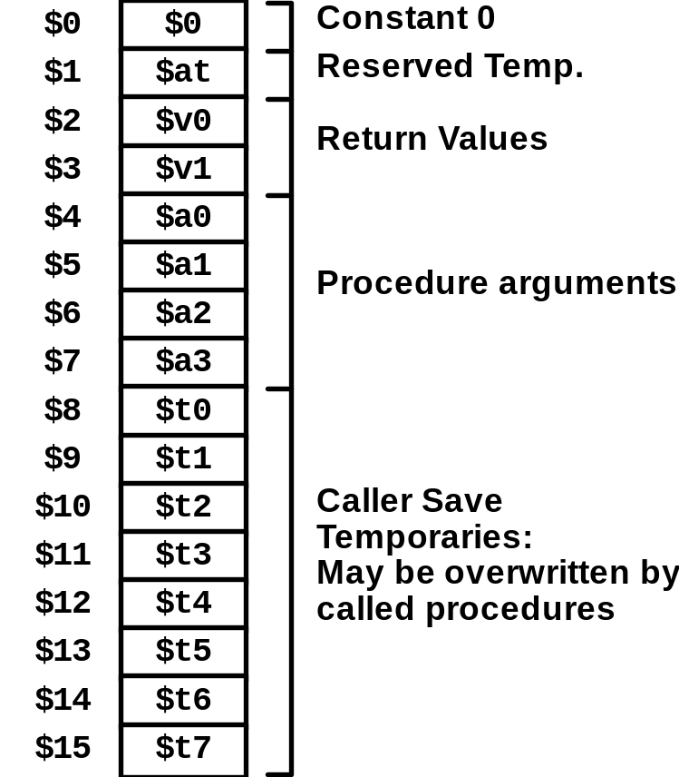
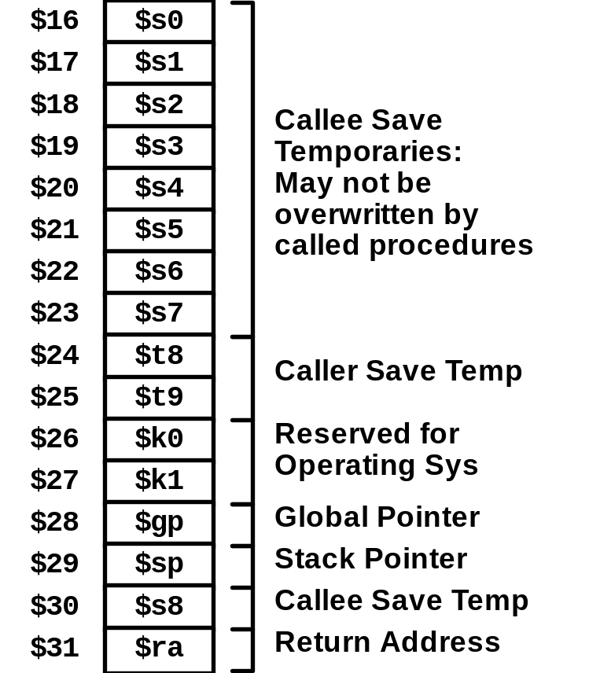
MIPS Registers

Slide 59
MIPS Instruction Examples
R-R
Op
Ra
Rb
Rd
00000
Fn
addu $3,$2,$1 # Register add: $3 = $2+$1
R-I
Op
Ra
Rb
Immediate
addu $3,$2, 3145 # Immediate add: $3 = $2+3145
sll $3,$2,2 # Shift left: $3 = $2 << 2
Branch
Op
Ra
Rb
Offset
beq $3,$2,dest # Branch when $3 = $2
Load/Store
Op
Ra
Rb
Offset
lw $3,16($2) # Load Word: $3 = M[$2+16]
sw $3,16($2) # Store Word: M[$2+16] = $3

Slide 60
CISC vs. RISC
Original Debate
  Strong opinions!
  CISC proponents---easy for compiler, fewer code bytes
  RISC proponents---better for optimizing compilers, can make run fast with simple chip design
Current Status
  For desktop processors, choice of ISA not a technical issue
    With enough hardware, can make anything run fast
    Code compatibility more important
  x86-64 adopted many RISC features
    More registers; use them for argument passing
  For embedded processors, RISC makes sense
    Smaller, cheaper, less power
    Most cell phones use ARM processor

Slide 61
Summary
Y86-64 Instruction Set Architecture
  Similar state and instructions as x86-64
  Simpler encodings
  Somewhere between CISC and RISC
How Important is ISA Design?
  Less now than before
    With enough hardware, can make almost anything go fast

Slide 62
Overview of Logic Design
Fundamental Hardware Requirements
  Communication
    How to get values from one place to another
  Computation
  Storage
Bits are Our Friends
  Everything expressed in terms of values 0 and 1
  Communication
    Low or high voltage on wire
  Computation
    Compute Boolean functions
  Storage
    Store bits of information

Slide 63
Digital Signals
0
1
0
Voltage
Time
  Use voltage thresholds to extract discrete values from continuous signal
  Simplest version: 1-bit signal
    Either high range (1) or low range (0)
    With guard range between them
  Not strongly affected by noise or low quality circuit elements
    Can make circuits simple, small, and fast

Slide 64
Additional Slides

Slide 65
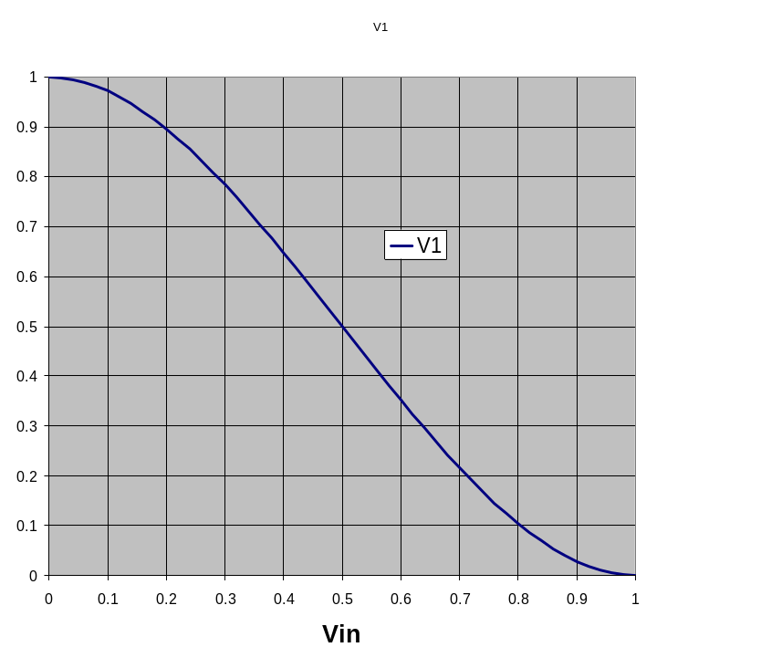
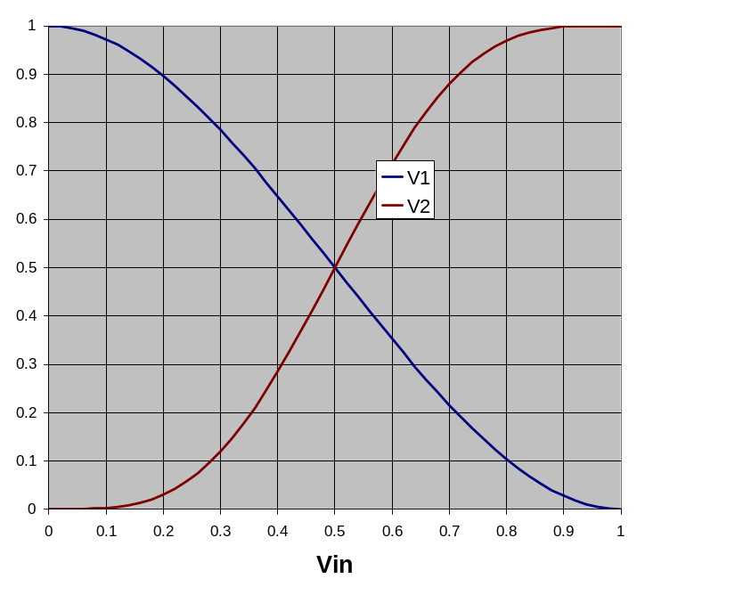
Storing 1 Bit
Bistable Element
q
Q+
!q
Q–
q = 0 or 1
V₂
V_{in}
V₁

Slide 66
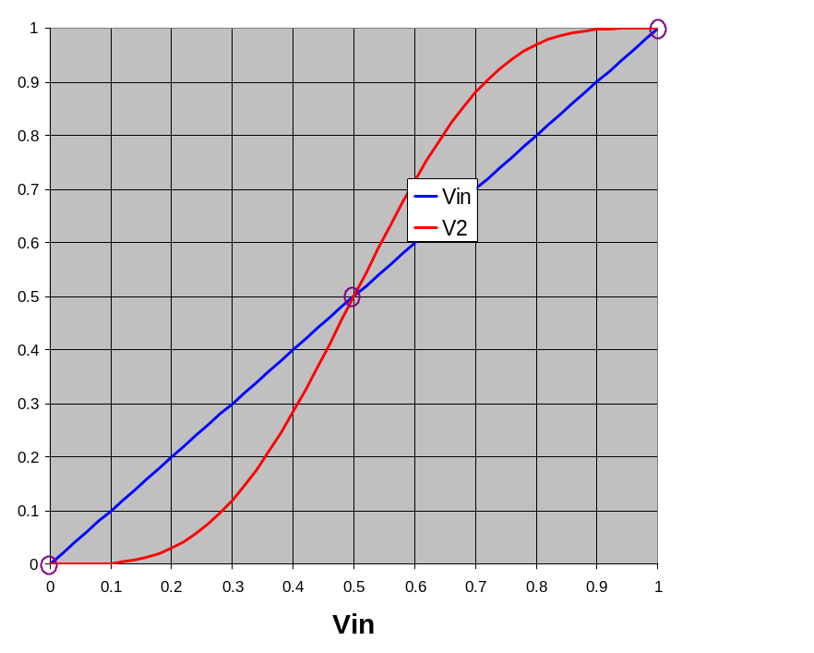
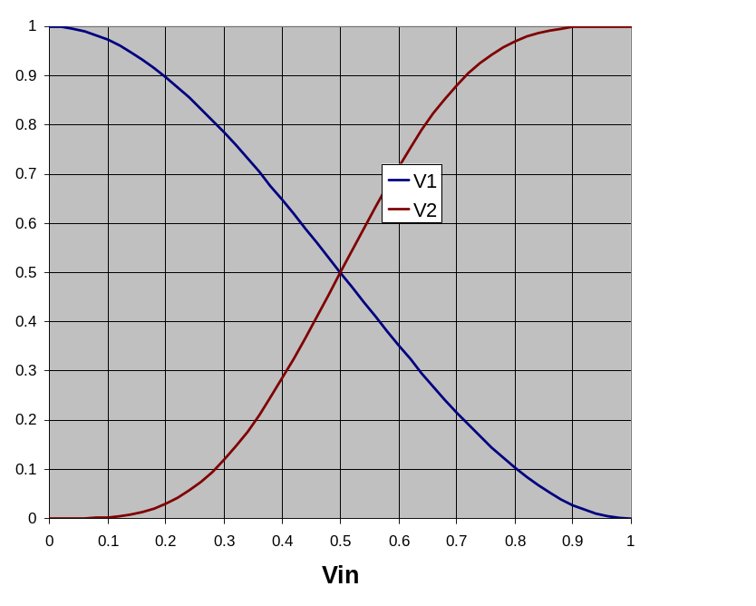
Storing 1 Bit (cont.)
Bistable Element
q
Q+
!q
Q–
q = 0 or 1
Stable 1
V_{in} = V₂
V₂
V₂
Metastable
V_{in}
V_{in}
V₁
V₁
Stable 0

Slide 67
Physical Analogy
Stable 1
Metastable
Stable 0
Metastable
.
Stable left
Stable right
.
.

Slide 68
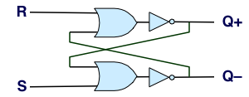
Storing and Accessing 1 Bit
Bistable Element
R-S Latch
q
R
Q+
Q+
!q
Q–
Q–
S
q = 0 or 1
Resetting
Setting
Storing
1
1
0
0
0
1
0
!q
q
0
0
1
1
1
0
0
q
!q

Slide 69
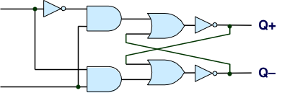
1-Bit Latch
D Latch
D
R
Data
Q+
C
Q–
Clock
S
Latching
Storing
d
!d
!d
!d
d
d
!d
0
!q
q
1
0
!q
d
d
!d
0
q

Slide 70
Transparent 1-Bit Latch
Latching
Changing D
d
!d
!d
!d
d
C
D
1
Q+
d
d
!d
Time
  When in latching mode, combinational propogation from D to Q+ and Q–
  Value latched depends on value of D as C falls

Slide 71
Edge-Triggered Latch
D
R
Data
Q+
Q–
C
S
T
Clock
Trigger
  Only in latching mode for brief period
    Rising clock edge
  Value latched depends on data as clock rises
  Output remains stable at all other times
C
T
D
Q+
Time

